Slide 1
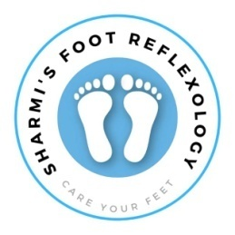
SHARMI’S FOOT REFLEXOLOGY
Care your feet

Slide 2
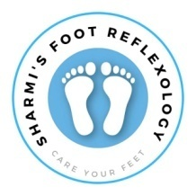
What is Foot Reflexology?
Foot Reflexology: A therapeutic practice based on applying pressure to specific points on the feet.
These points are believed to correspond to different organs and systems in the body
Mechanism: Through stimulation of these points, reflexology aims to enhance overall health and restore balance.

Slide 3
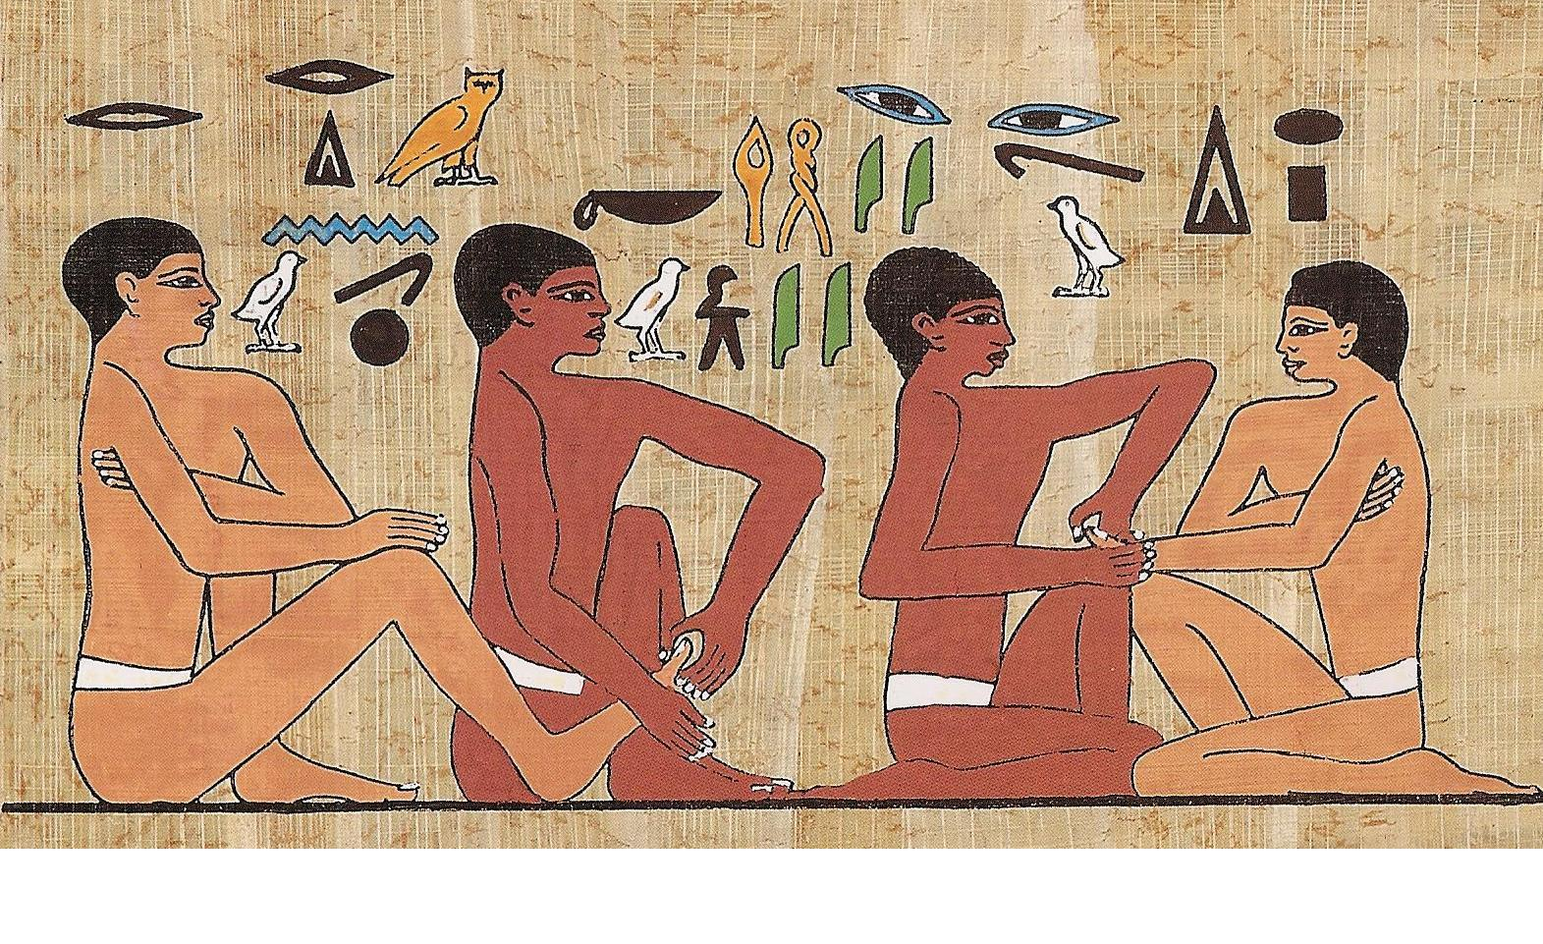
Historical Background
Ancient Egypt: Evidence from the tomb of Ankhmahor (around 2330 BC) showing foot and hand reflexology.
China: Descriptions in the Huang Di Nei Jing, which detail techniques for stimulating reflex points on the body’s extremities
India: Practices related to Ayurveda that involve balancing energy within the body, similar to reflexology concepts.

Slide 4
Core Principle:
Reflexology posits that feet have reflex zones that correspond to every organ and system in the body.
By stimulating these zones, reflexologists aim to improve health and wellbeing

Slide 5
How Reflexology Works

Slide 6
Reflex Points and Zones
Head and Brain:Located on the tips of the toes, particularly the big toe.
Heart and Lungs:Found on the ball of the foot; left foot is linked to the heart and both feet to the lungs.
Digestive System:The arch of the foot reflects the stomach, intestines, and other digestive organs
Kidneys and Bladder:These points are located on the heel and the lower part of the foot.

Slide 7
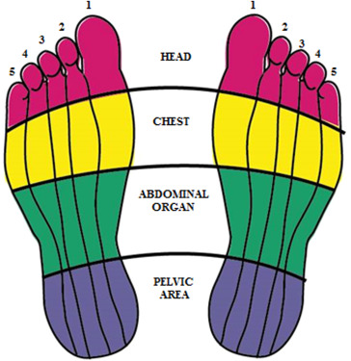
Reflex Zones

Slide 8
Pressure Mechanism:
Nerve Stimulation:
Process: Applying targeted pressure to reflex points stimulates nerve endings that may enhance function and alleviate discomfort.
Effect: Can lead to pain relief, improved organ function, and overall wellness.
Circulation Enhancement:
Impact: Stimulating reflex points can improve blood flow and lymphatic drainage, helping to detoxify and nourish cells.

Slide 9
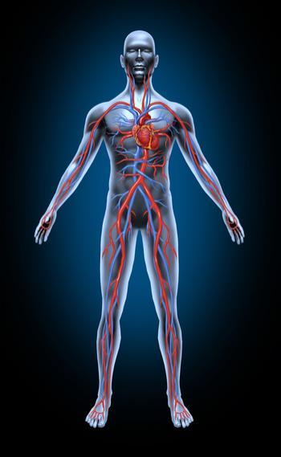
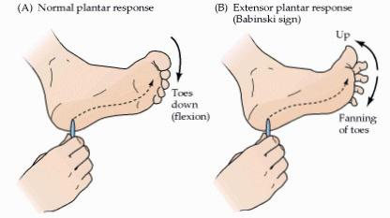

Slide 10
Energy Flow
Meridian Theory:
Concept: Traditional Chinese Medicine (TCM) believes in energy pathways (meridians) that affect health.
Reflexology’s Role: By stimulating specific reflex points, reflexology aims to balance these energy pathways and promote optimal health.

Slide 11
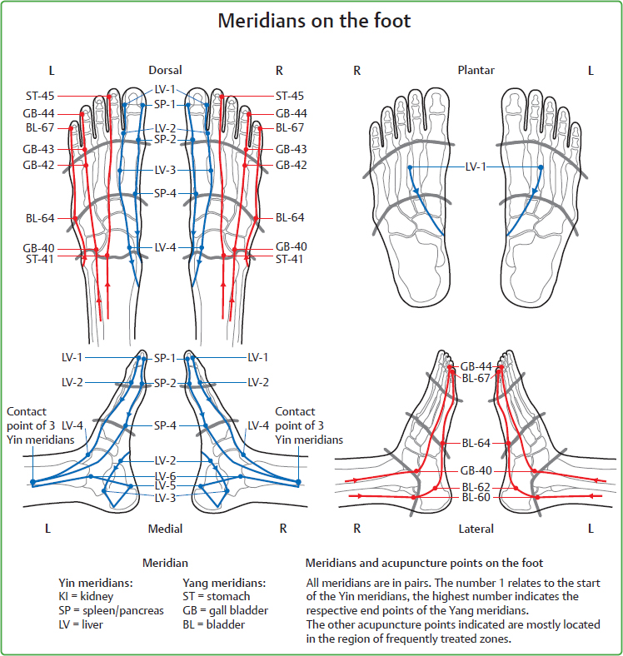

Slide 12
Anatomy of the Foot

Slide 13
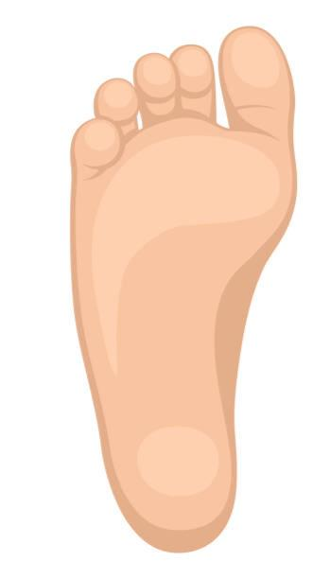
How foot connected to other areas
Toes:
Big Toe: Reflects the head and brain. Techniques for migraines and cognitive enhancement focus here.
Other Toes: Smaller toes reflect sinus areas and other head-related points.
Ball of the Foot:
Heart: Center part of the ball, especially on the left foot.
Lungs: Surrounding area on both feet.

Slide 14
Arch:
Digestive System: Represents organs such as the stomach and intestines. Techniques can improve digestion and relieve related issues can heel
Lower Back: Associated with the lower back, pelvis, and reproductive organs. Techniques can aid in lower back pain and pelvic discomfort

Slide 15
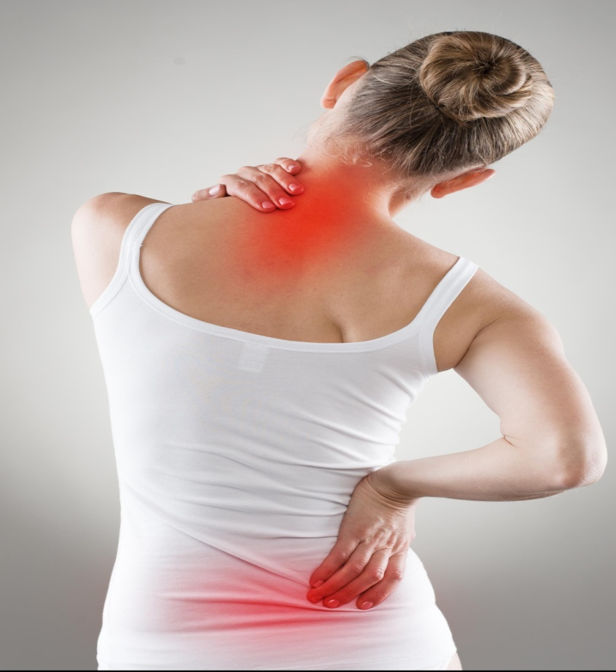
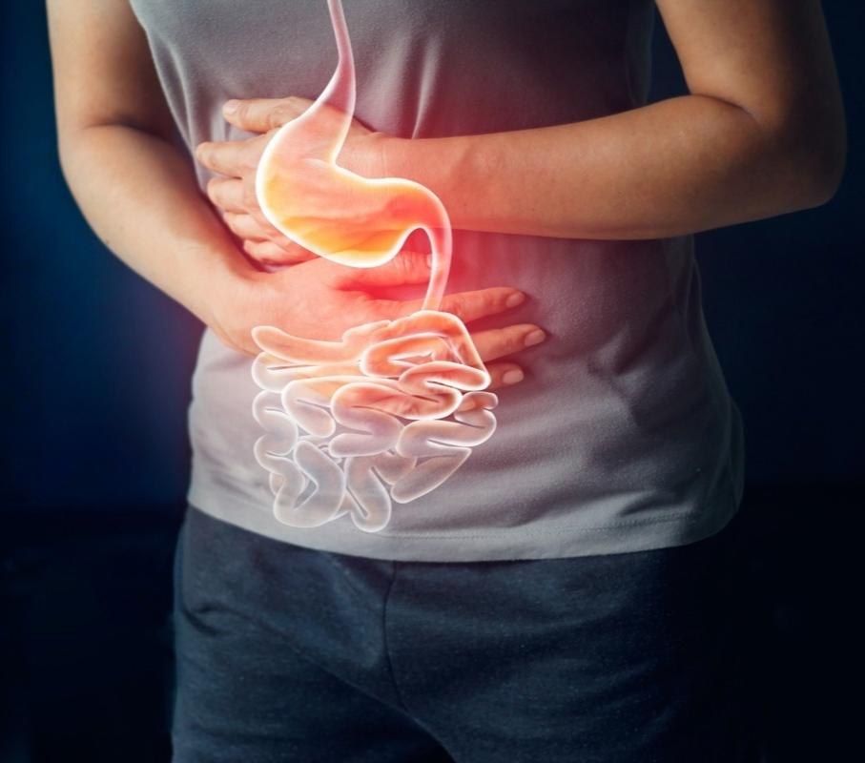

Slide 16
Foot Structure
Bones:
Phalanges: Toe bones crucial for walking and balance.Metatarsals: Support body weight and facilitate movement.
Tarsals: Include the calcaneus (heel bone) and other bones supporting the rear-foot structure.
Muscles and Tendons:
Flexors and Extensors: Key muscles involved in foot movements; important for stability and walking.

Slide 17
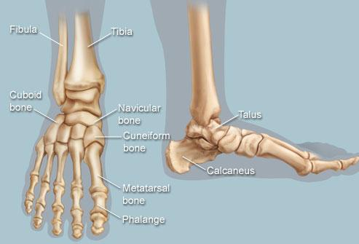
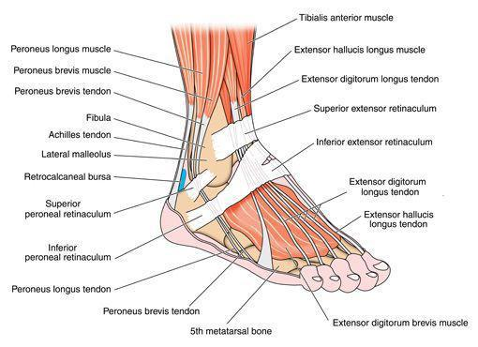
Nerves and Circulation:
Major Nerves: Tibial nerve, peroneal nerve, and their role in foot sensations and reflexes.Circulatory System: Arteries and veins crucial for blood flow and overall foot health.

Slide 18
Techniques and Methods

Slide 19
Basic Techniques
Thumb Walking:
Using the thumb to apply steady pressure in a walking motion along reflex zones.
Purpose: Stimulates a large area of reflex points, effective for overall treatment
Finger Pressure
Description: Applying pressure with fingers in circular or pressing motions to target specific reflex points.
Purpose: Allows precise stimulation of reflex points, useful for targeted issues

Slide 20
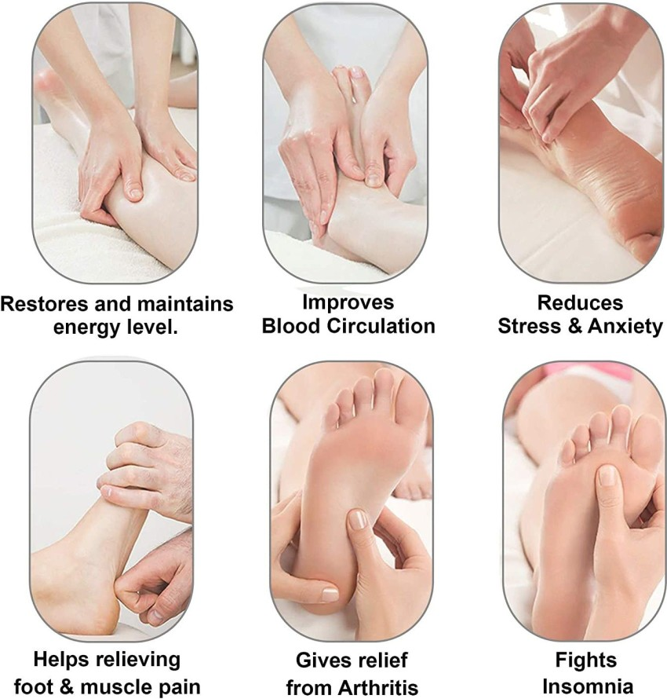
Kneading:
Description: Using both hands to knead the foot, applying pressure and releasing tension.
Purpose: Relaxes foot muscles, enhances blood flow, and supports overall relaxation.

Slide 21
Reflexology Tools:
Charts and Maps:
Usage: Visual tools showing reflex points and their associated organs. Essential for practitioners and self-practice.
Massage Tools:
Rollers: Devices that roll over the foot to stimulate reflex points.
Reflexology Sticks: Precision tools used for applying targeted pressure to specific points

Slide 22
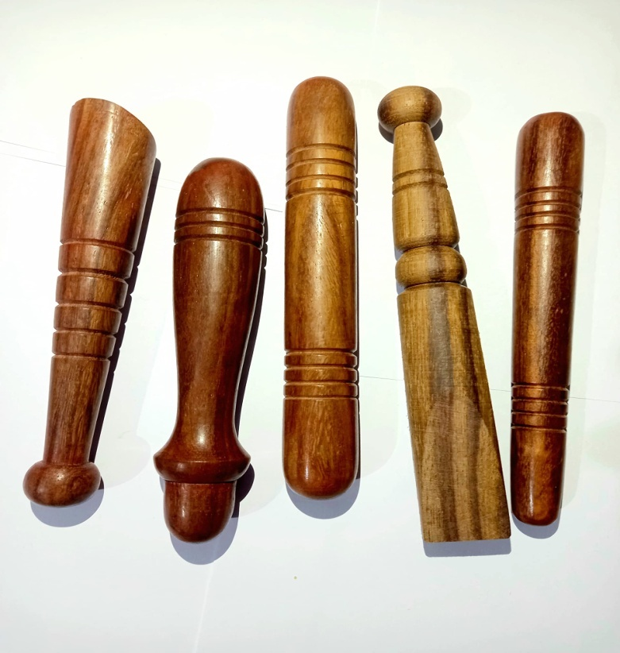
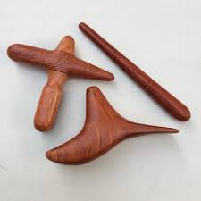
Reflexology Tools

Slide 23
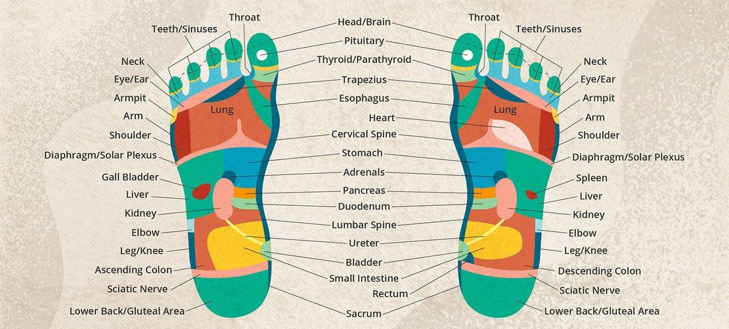
Foot Reflexology Chart

Slide 24
Benefits of Foot Reflexology

Slide 25
Physical Benefits:
Improved Circulation:
Mechanism: Enhances blood flow to extremities and organs, improving overall bodily functions.
Impact: Supports cardiovascular health and helps in tissue repair.
Pain Relief:
Conditions: Effective for chronic pain such as arthritis, migraines, and back pain.
Evidence: Studies show significant pain reduction and improved quality of life for sufferers.

Slide 26
Enhanced Immune Function:
Effect: May boost immune responses by stimulating reflex points related to immune function.
Evidence: Some studies suggest increased immune activity and reduced illness frequency

Slide 27
Mental and Emotional Benefits
Stress Reduction:
Process: Activates relaxation responses, reducing cortisol levels and promoting mental calm.
Evidence: Research shows reflexology can significantly lower stress and anxiety levels.
Improved Sleep Quality:
Mechanism: Promotes relaxation and alleviates stress, aiding in better sleep.
Evidence: Many individuals report improved sleep patterns and reduced insomnia symptoms.

Slide 28
Emotional Balance:
Impact: Helps stabilize mood and reduce symptoms of depression and anxiety through relaxation and stress relief.

Slide 29
Common Reflexology Techniques

Slide 30
Common Reflexology Techniques
Preparation:
Setting: Ensure a serene environment with comfortable seating and ambient lighting.
Foot Preparation: Clean and warm the feet. Use a foot soak or warm towel if desired.
Warm-Up:
Gentle Rubbing: Light strokes and warm-up techniques to prepare the foot for deeper work.
Purpose: Helps in relaxing the muscles and enhancing blood flow.

Slide 31
Focused Reflexology Work:
Targeted Application: Use specific techniques on identified reflex points based on individual needs.
Variation: Adjust pressure and technique based on feedback and comfort level.
Cool Down:
Soothing Strokes: End with light, relaxing strokes to promote overall relaxation and finish the session gently

Slide 32
Evidence and Research

Slide 33
Scientific Studies
Pain Management:
Study: "Effect of Reflexology on Pain Management" (Journal of Pain Research) – Shows significant pain reduction in various conditions.
Details: Includes quantitative measures of pain reduction and patient-reported outcomes.
Stress Relief:
Study:
"Reflexology for Stress Reduction: A Meta-Analysis" (Complementary Therapies in Medicine) – Demonstrates significant reductions in stress markers.
Details: Reviews multiple studies and highlights common findings.

Slide 34
Case Studies
Example: Case of a patient with chronic migraines who experienced relief through regular reflexology sessions.
Details: Personal account, including treatment frequency, techniques used, and results observed.

Slide 35
Criticism and Limitations
Scientific Debate: Discuss the variability in study quality and the need for more rigorous research.
Limitations: Highlight situations where reflexology might not be effective or applicable, such as in acute medical emergencies.

Slide 36
Thank you

